Slide 1
YARN Yet Another Resource Manager

Slide 2
MapReduce 1 Versus Yarn
MapReduce 1 has three main components
API for user-level programming of MapReduce applications
Framework – runtime services for running Map and Reduce processes, shuffling and sorting, etc.
Resource management – infrastructure to monitor nodes, allocate resources and schedule jobs
MapReduce 2 moves Resource Management into YARN
MapReduce 2
Spark
MapReduce 1
MR API
Spark API
MR API
Framework
Framework
Framework
YARN
Resource Management
YARN API
Resource Managment

Slide 3
Why we need Yarn?
What is wrong with MapReduce version 1?
Inflexible “slots” configured on nodes – Map or Reduce, not both
Underutilization of cluster when more map or reduce tasks are running.
Can’t share resources with non-MapReduce applications running on Hadoop cluster (e.g. Impala, Giraph, spark)
Salability
One JobTracker per cluster
Limit of about 4000 nodes per cluster.

Slide 4
Yarn Solutions
No slots
Nodes have “resources” (memory and CPU cores) which are allocated to applications when requested
Supports MapReduce and non-MapReduce applications running on the same cluster
Most Job Tracker functions moved to Application Master
One cluster many Application Masters
Job Tracker
Resource Manager
Application Master

Slide 5
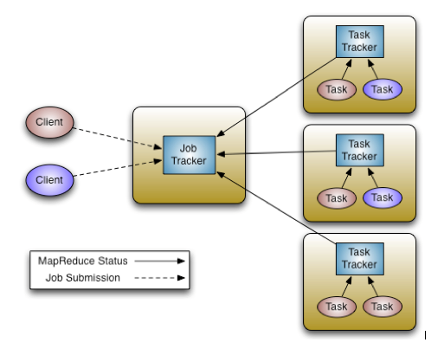
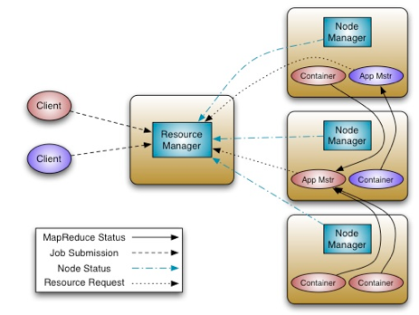
MapReduce 1 Versus Yarn
Map Reduce 1
Job Tracker does both resource allocation and scheduling of individual Map and Reduce tasks
Yarn
Resource Manager only does resource allocation
CPU and RAM

Slide 6
Yarn
Resource Manager
Runs on master node
Global resource scheduler
Arbitrates system resources between competing applications.
Node Manager
Runs on slave nodes
Communicates with resource manager

Slide 7
Yarn
Containers
Created by the resource manager upon request
Allocate a certain amount of resources (memory, CPU) on a slave node
Applications run in one or more containers
Application Master
One per application
Kind of the mastermind for an application
Framework/application specific
Run in a container
Requests more containers to run application tasks
NodeManager
1 GB
1 core
3 GB
1 core
NodeManager
Application Master

Slide 8
Yarn
Client
NodeManager
YourApp
Client
Application MyApp
NodeManager
Application YourApp
Application Master
MyApp
Launch
NodeManager
Resource Manager
Launch
Container ID
Application Master
YourApp
Request Resources
Launch
NodeManager
MyApp

Slide 9
Resource Manager
Manages nodes
Tracks heartbeats from NodeManagers
Manages containers
Handles Application Master requests for resources
De-allocates containers when they expire or the application completes
Manages ApplicationMasters
Creates a container for Application Masters and tracks heartbeats
Manages security

Slide 10
Node Manager
Communicates with the resource manager
Registers and provides info on node resources
Sends heartbeats and container status
Manages processes in containers
Launches Application Managers on request from the Resource Manager
Launches application processes on request from Application Master
Monitors resource usage by containers; kills run-away processes.
Provides logging services to applications
Aggregates logs for an application and saves them to HDFS
Maintains node level security

Slide 11
Resource Request
Resource Request (container requests)
Resource name (hostname, rackname or *)
Priority (within this application not between applications)
Higher priority container will get resources quicker.
Resource requirements
RAM (MB)
CPU (# cores)
Will be supported later (e.g. disk, network IO, GPU, etc.)
Number of containers
NodeManager
Resource Manager
Application Master

Slide 12
Some Other Applications that Run on Yarn
Impala
Apache Giraph
Storm
Spark
Etc.

